Slide 1

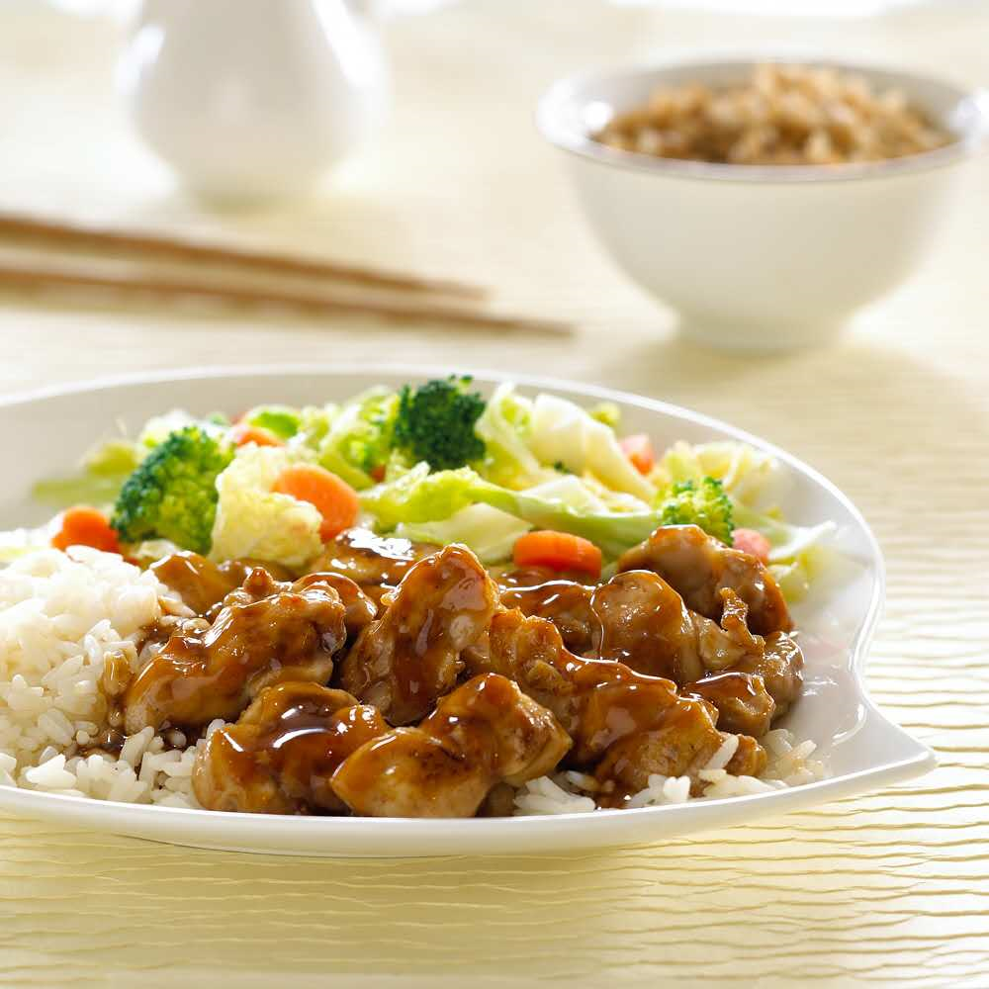

SPECIAL OF THE DAY
TERIYAKI
SERVER WITH: • Steamed Rice • Mixed Vegetables
ITEM 1
ITEM 2
ITEM 3
ITEM 4
Chicken Teriyaki $6.39
640 Cal
SERVED WITH: • Mixed Vegetables • Steamed Rice
ITEM 5
Substitute Steamed
Rice with
Extra Chicken $1.69
(4 oz.) 170 Cal

Slide 2



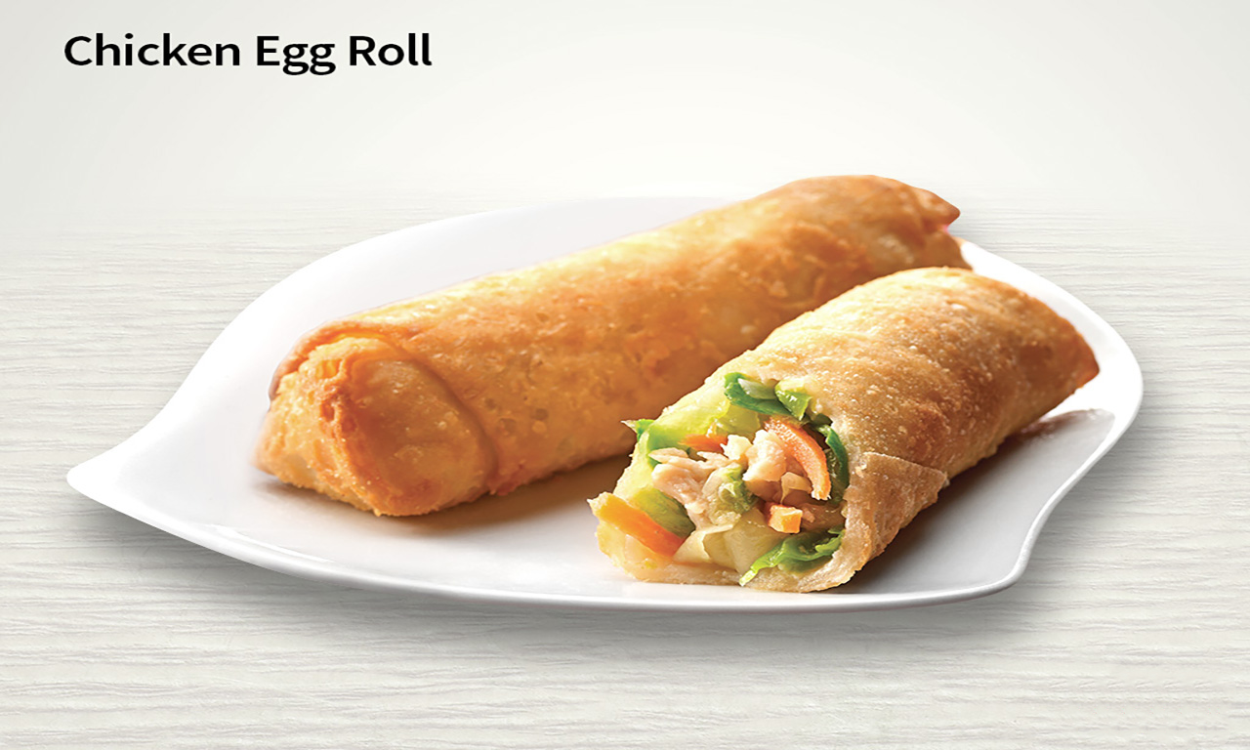

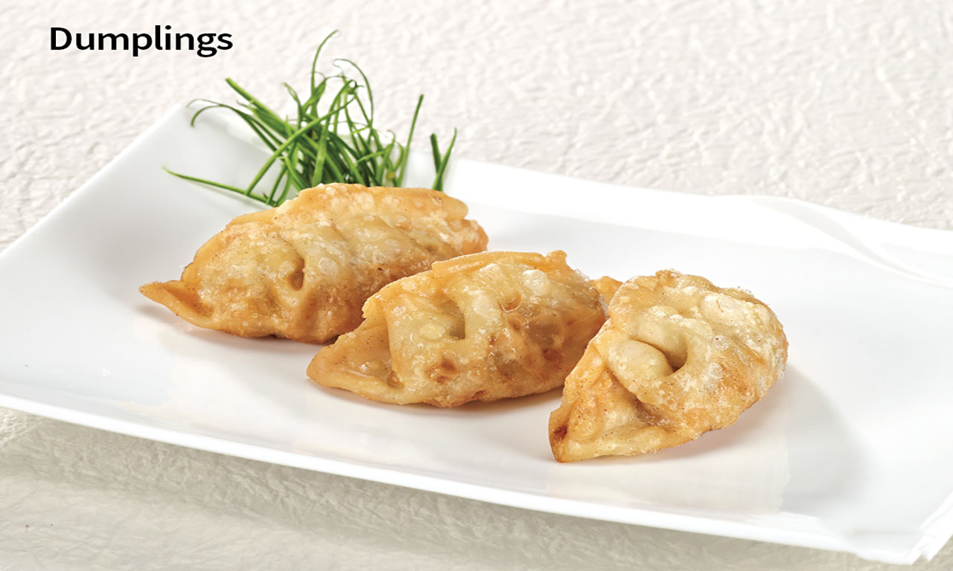
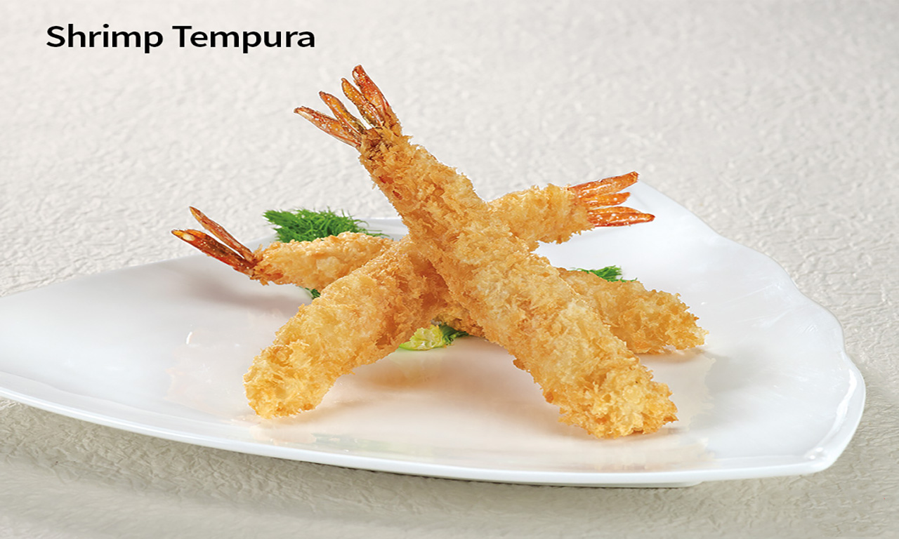




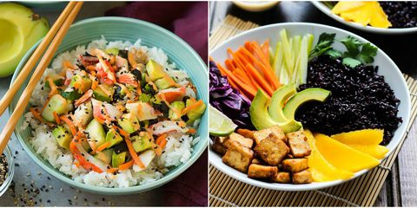
SIDE ORDERS
BEVERAGES
Coke Drinks | Small 0-260 Cal 1.79
 | Regular 0-380 Cal 1.99
Lemonade | 190-250 Cal 1.99
Bottled Water | 0 Cal 1.19
Hot Green Tea | 0 Cal 1.19
Bottle Drink | 10-230 Cal 2.19
190 Cal
0.99
160 Cal
1.39
260 Cal
2.49
390 Cal
3.59
VEGETARIAN
Mixed vegetables & steamed rice
3.49
410 Cal
2,000calories a day is used for general nutrition advice, but calorie needs vary. Additional nutrition information available upon request.

